Slide 1
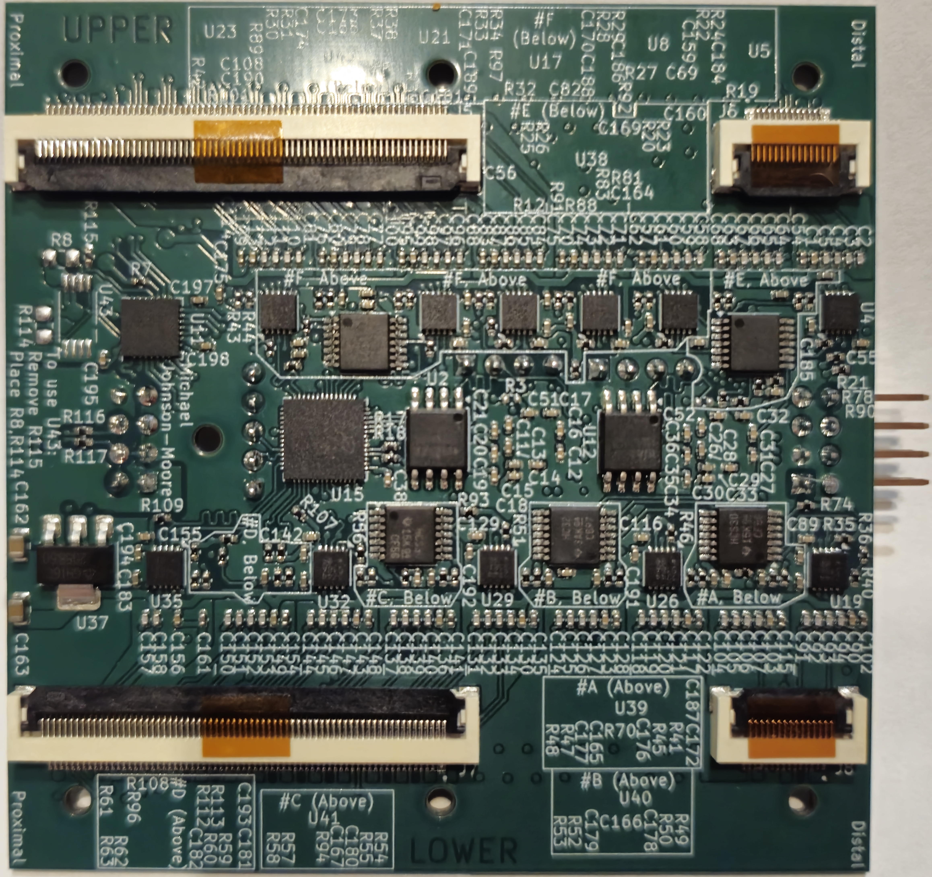
Back of Circuit Board
Notes:
This slide is opaque.

Slide 2



Back of Circuit Board
USB Hub
(Splits USB signal from computer into 4 ports)
Capacitive Sensor Controller
2-4 mm
Power Supply
Hardcoded Logic
Notes:
This slide is opaque.

Slide 3
USB Hub
(Splits USB signal from computer into 4 ports)
Capacitive Sensor Controller
2-4 mm
Power Supply
Hardcoded Logic
Notes:
This slide is transparent

Slide 4
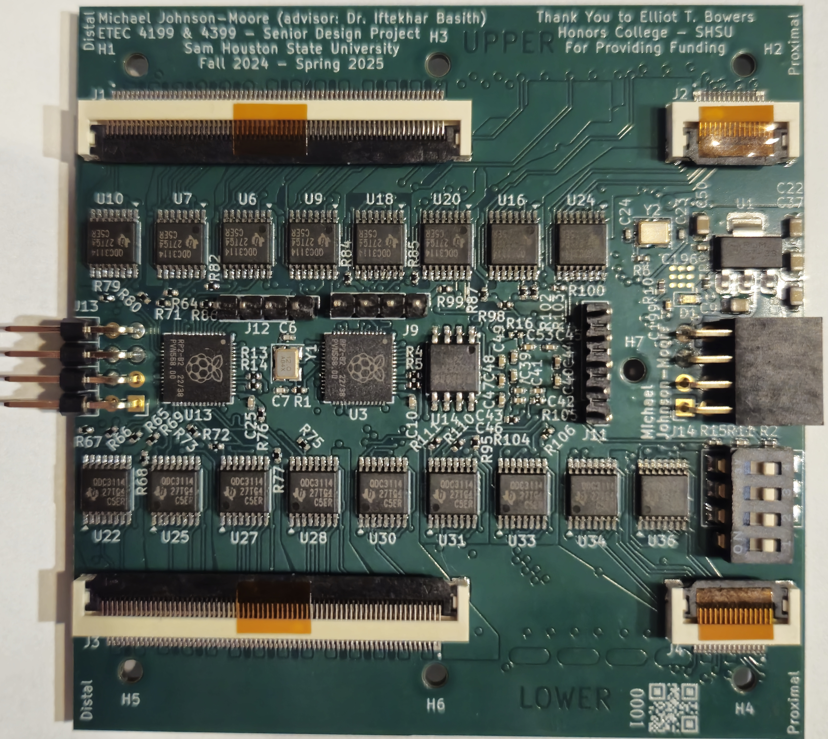
Front of Circuit Board
Notes:
This slide is opaque

Slide 5
Front of Circuit Board
Connectors for Sensor Boards
Power Supply
Raspberry Pi RP2040
And supporting chips
Debugging
Inductive Sensor Controller
RP2040
Program storage
Timing Crystal
12.5 mm
Notes:
This slide is opaque

Slide 6
Connectors for Sensor Boards
Power Supply
Raspberry Pi RP2040
And supporting chips
Debugging
Inductive Sensor Controller
RP2040
Program storage
Timing Crystal
12.5 mm
Notes:
This slide is transparent

Slide 7
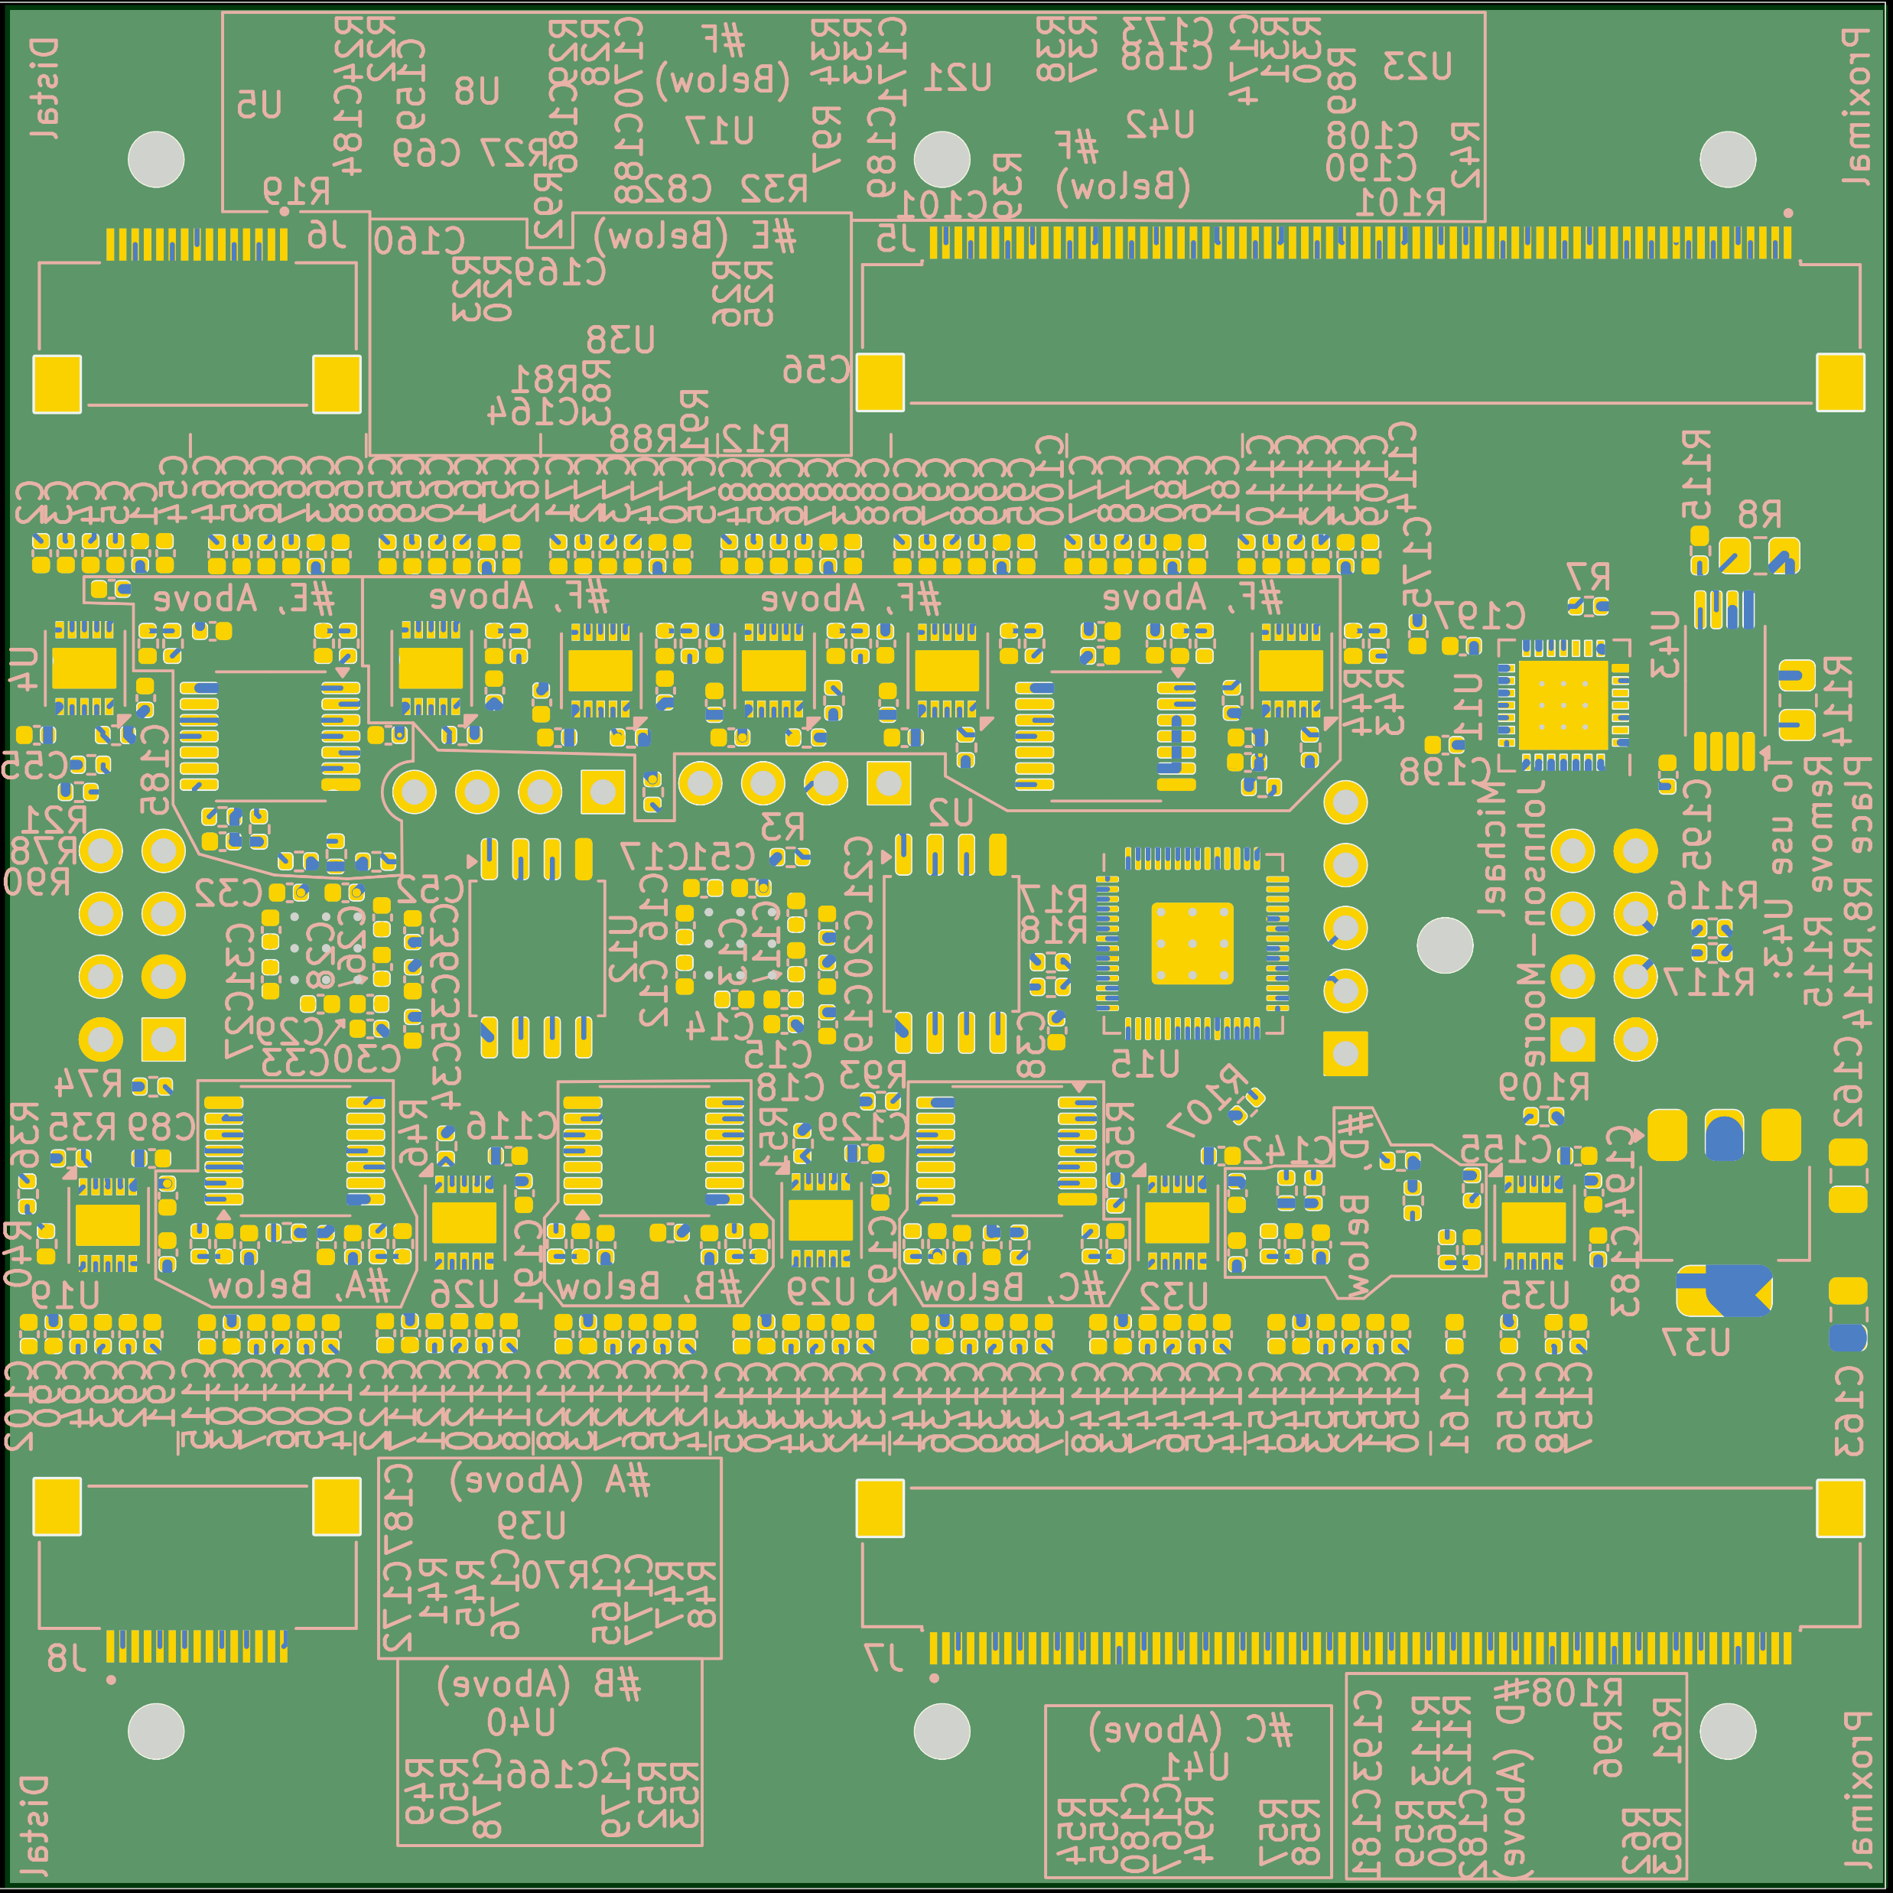
Internal Layers of Circuit Board
Gold Plating
Soldermask
Bottom Text
Notes:
This slide is opaque

